Slide 1
Live in State You Can Afford, Avoid Ones You Can’t
Stephanie Liechty

Slide 2
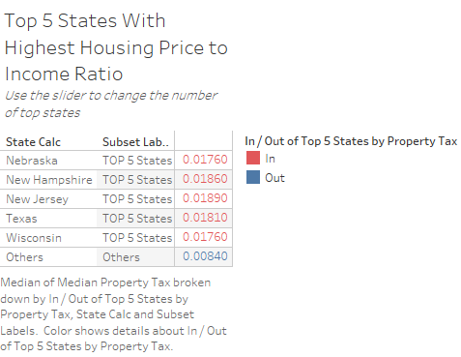
Top 5 States With Highest Housing Price to Income Ratio
This visualization highlights the top five states in the US with the highest housing price-to-income ratio. The ratio is a key indicator of housing affordability, reflecting the relationship between median home prices and household income. Some types of insights we can expect to gain:
Affordability Concerns
Regional Patterns
Policy Implications

Slide 3
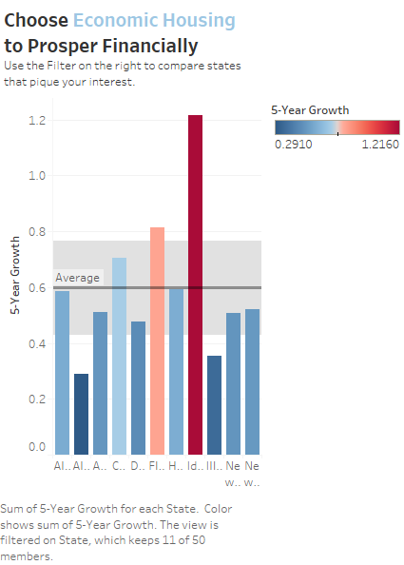
5-Year Growth in Interest Rates for the Top 11 States
This visualization provides an analysis of the 5-year growth in interest rates for the top 11 states. Understanding interest rate trends over time is crucial for evaluating the broader economic environment and its impact on the housing market.

Slide 4
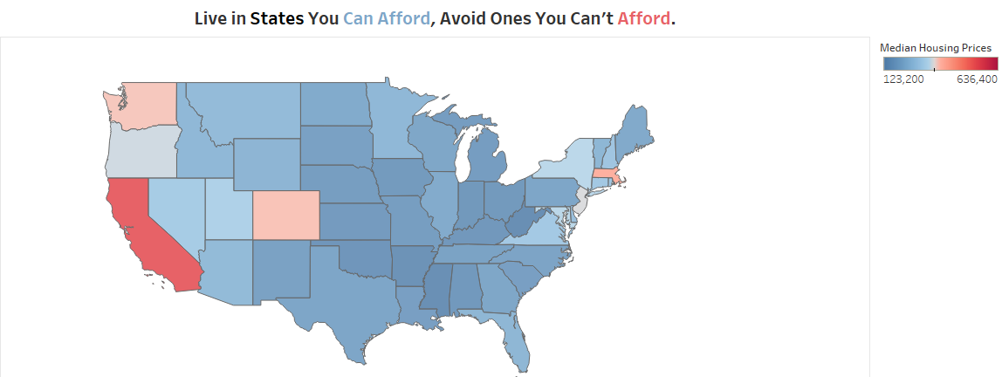
Geographical Distribution of Housing Prices in the U.S.
This visualization features a geographical map of the United States, visually representing the variation in housing prices across different states. The states are color-coded to indicate relative housing prices, with a gradient from blue (less expensive) to red (more expensive). This map provides an easy affordability analysis and potential investment opportunities. Hovering over each state provides the median housing price and the cheapest and most expensive cities for each state.

Slide 5
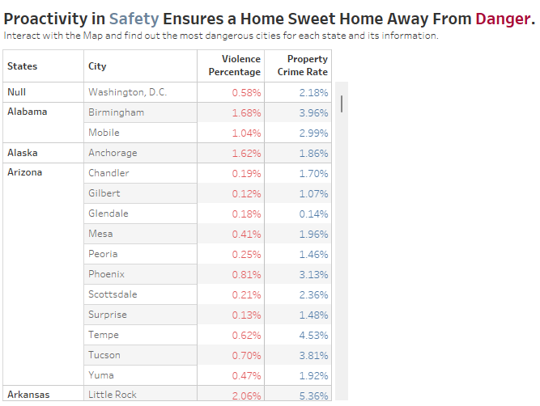
Most Dangerous Cities in Each State
This visualization provides an overview of the most dangerous cities in each state, with a snapshot focusing on the first three states and Washington D.C. The analysis is based on crime data, showcasing cities with the highest crime rates, which is a crucial aspect of evaluating living conditions and safety in different areas.

Slide 6
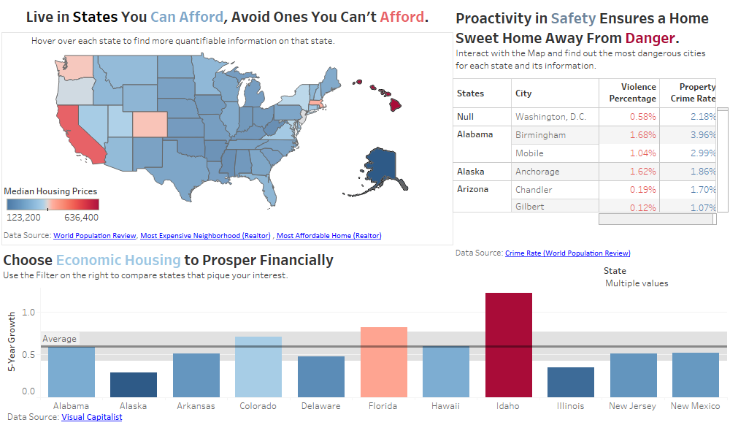
Comprehensive Housing and Safety Dashboard
This dashboard provides a holistic view of housing affordability, safety, and economic trends across the United States. By integrating crime rates, a geographical map of housing prices, median housing prices for each state, and the 5-year growth rate of interest rates for the top 11 states, this dashboard offers a multifaceted analysis useful for policymakers, investors, and home buyers.

